Slide 1
REMOTE ACCESS TOOL
Ungureanu Florin-Catalin

Slide 2
General Presentation
There are situations when the owner has a certain number of servers which are maintained by employees and he can not be always physically present to check their activities. A person who works in IT assistance might need remote control of the computers in which the troubleshooting is performed. Other situations can be colaboration, online meetings and conferencing between the employees within a company. In order to solve these problems this project aims to offer the possibility for the administrator to have full access to his remote servers. Therefore he gains full capability to supervise the activity of his employees and he can also take control when is needed. Whenever a technical issue arises, the maintenance of the servers is assured by the person in charge using RAT.
Outside of the industry this application can be also used for personal needs.

Slide 3
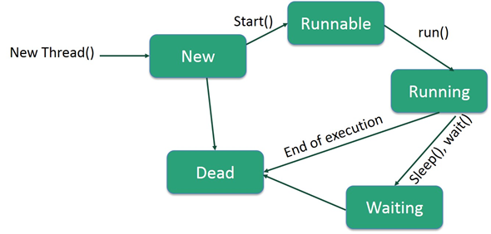
Theoretical Fundamentals
THREADS
Lifecycle

Slide 4
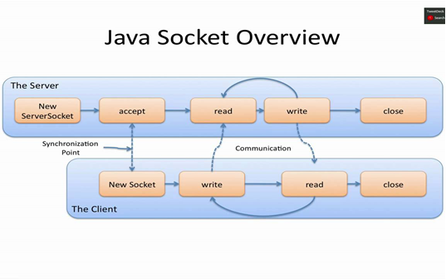
Theoretical Fundamentals
SOCKETS

Slide 5
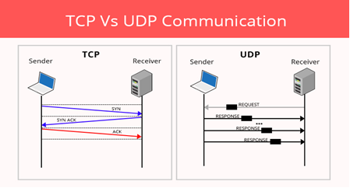
Theoretical Fundamentals

Slide 6
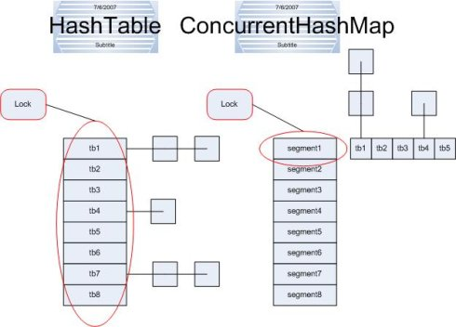
Theoretical Fundamentals
Hashtable vs. ConcurrentHashMap

Slide 7
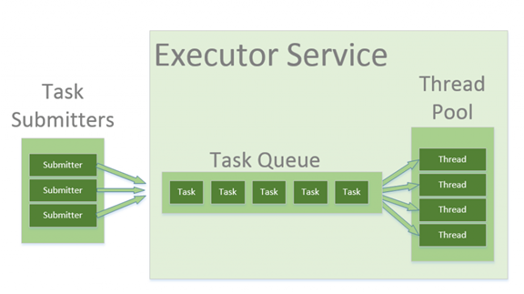
Theoretical Fundamentals
EXECUTORS

Slide 8
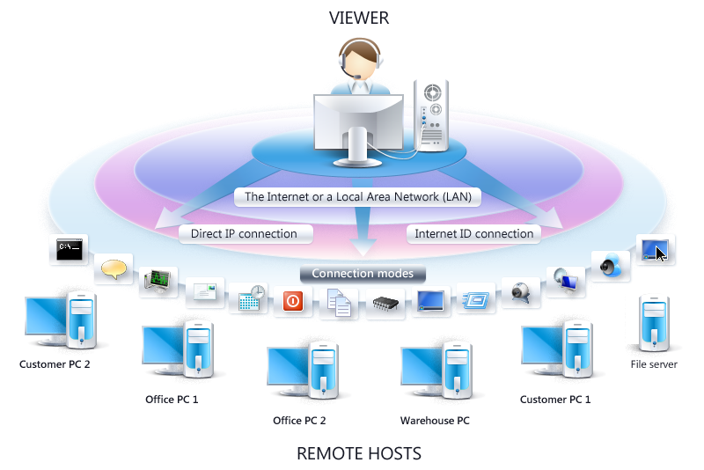
IT Technology
REMOTE ACCESS

Slide 9
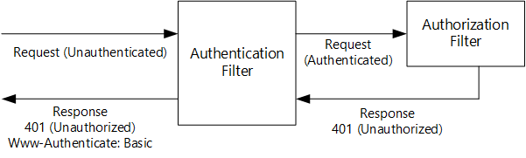
IT Technology
AUTENTIFICATION REQUEST

Slide 10
Functionalities
Supervising functionalities :
-recording the mouse events
-capturing keyboard
-visualising server’s screen
-using the camera
Control functionalities :
-access file system (create files, delete files, write files)
-send command via Command Prompt
-running code
-using applications

Slide 11
Actors and Related Accessrights
The actors are the client and the servers, the client having full access rights over the servers when the authentification succedes.

Slide 12
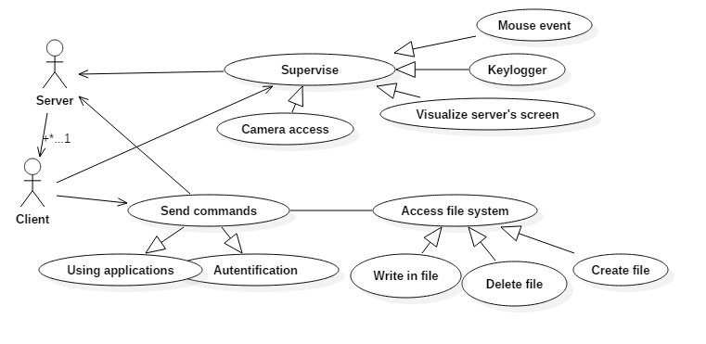
Usecase Diagram

Slide 13
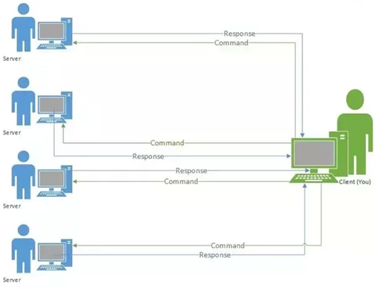
General Architecture Diagram

Slide 14
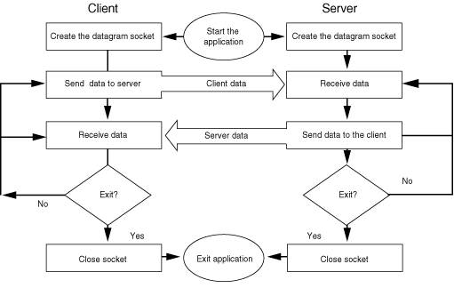
Design
FLOWCHART DIAGRAM

Slide 15
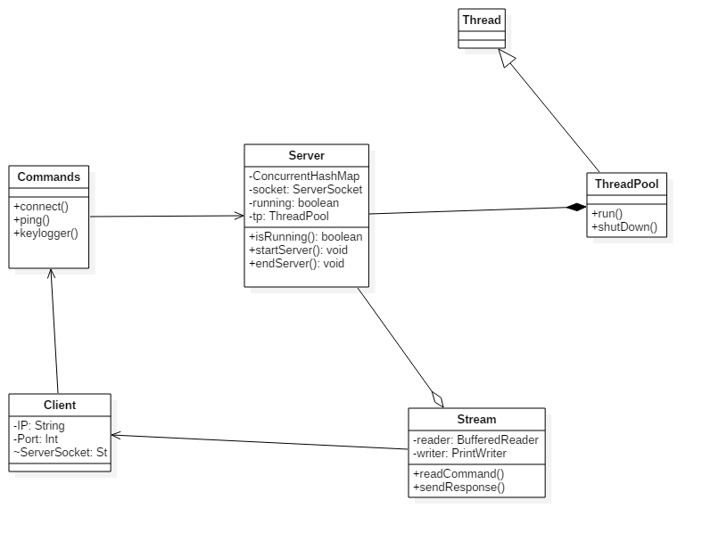
Design
Class Diagram

Slide 16
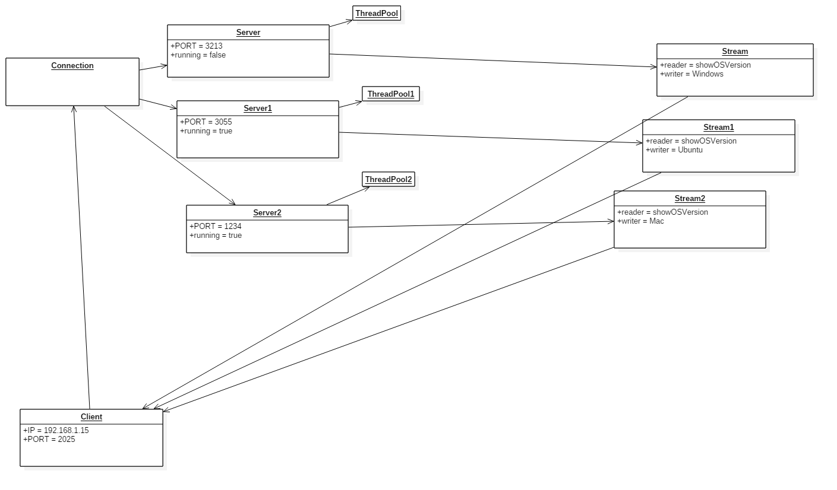
Design
Object Diagram

Slide 17
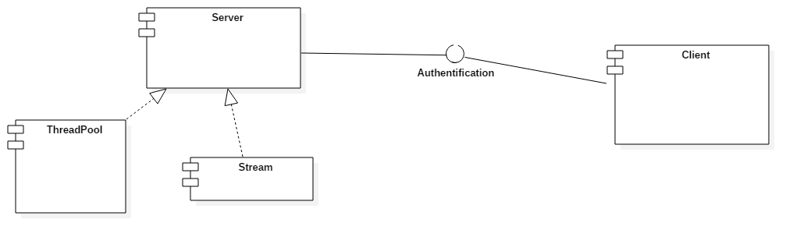
Design
Component Diagram

Slide 18
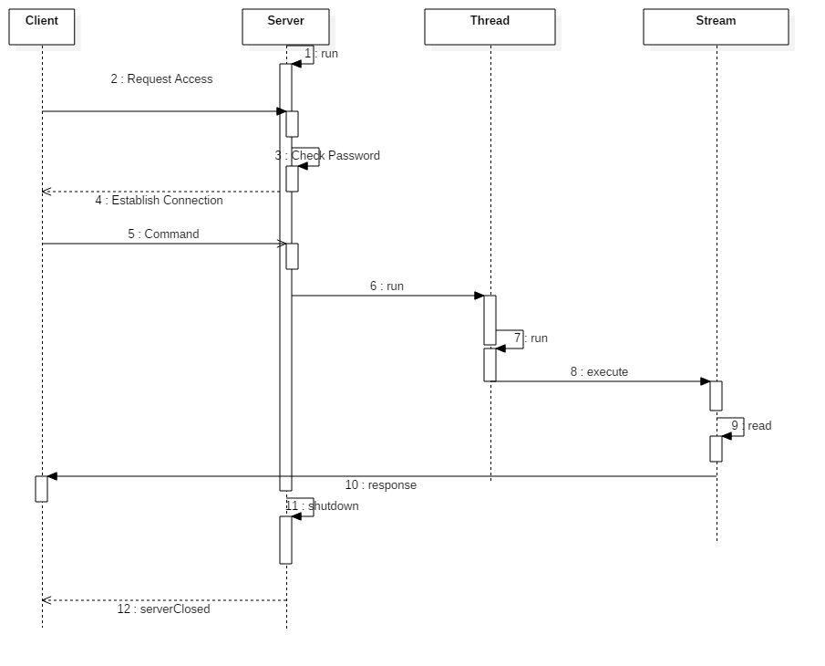
Design
Sequence Diagram

Slide 19
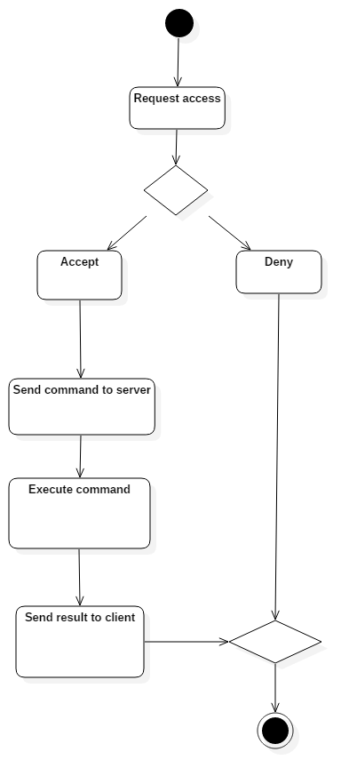
Design
Activity Diagram

Slide 20
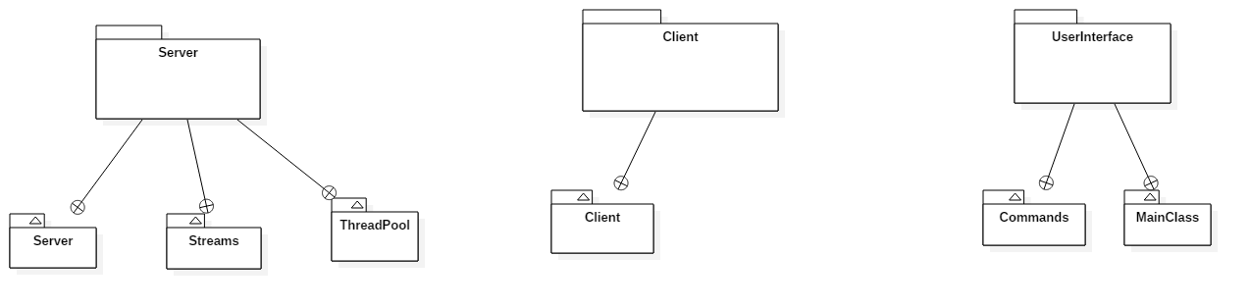
Design
Package Diagram

Slide 21
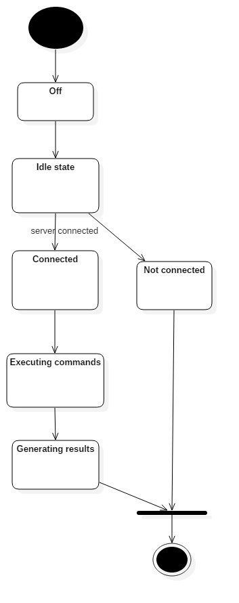
Design
State Transition Diagram

Slide 22
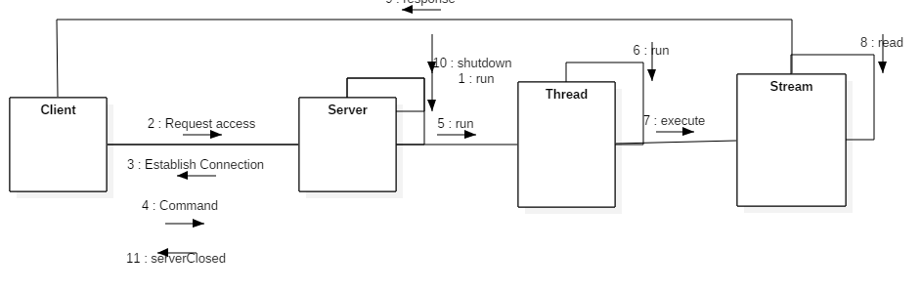
Design
Communication Diagram

Slide 23
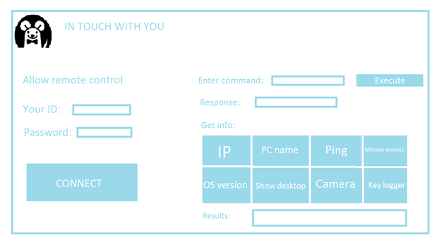
Operation Mode

Slide 24
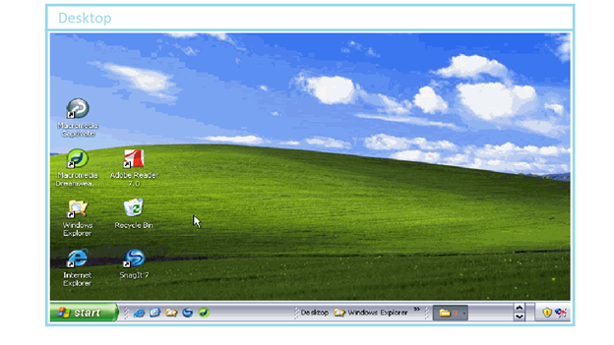
Operation Mode

Slide 25
Portability
The software is portable on all Windows machines as it was written in a portable programming language but, on the other hand is not portable on other operating systems such as Linux, Mac etc.

Slide 26
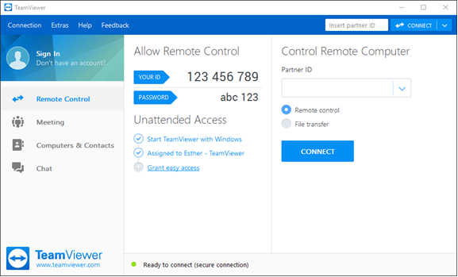
Competing software
TeamViewer

Slide 27
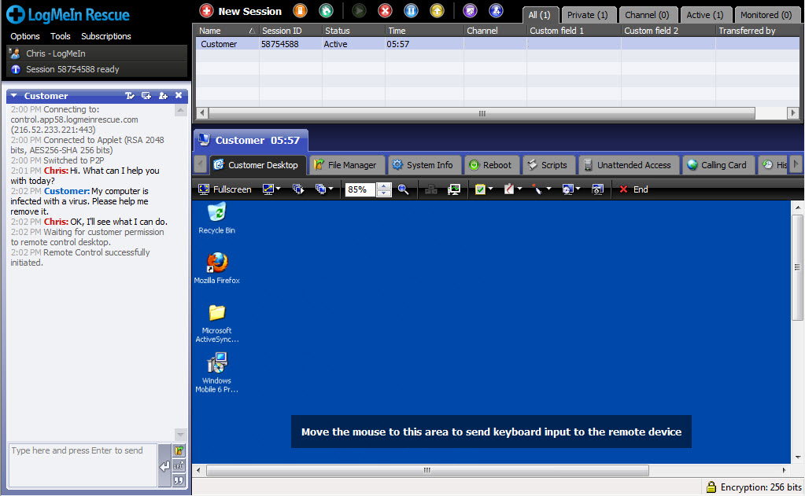
Competing software
LogMeIn

